Slide 1



Ethics in IT
Class IX
lab 3

Slide 2

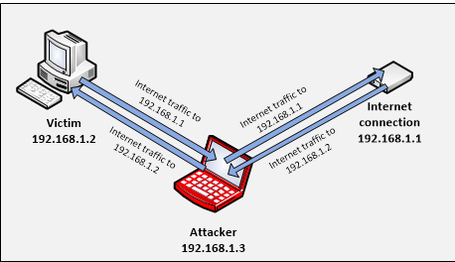
ARP Poisoning
ARP queries in the system to find out other machines’ MAC addresses

Slide 3
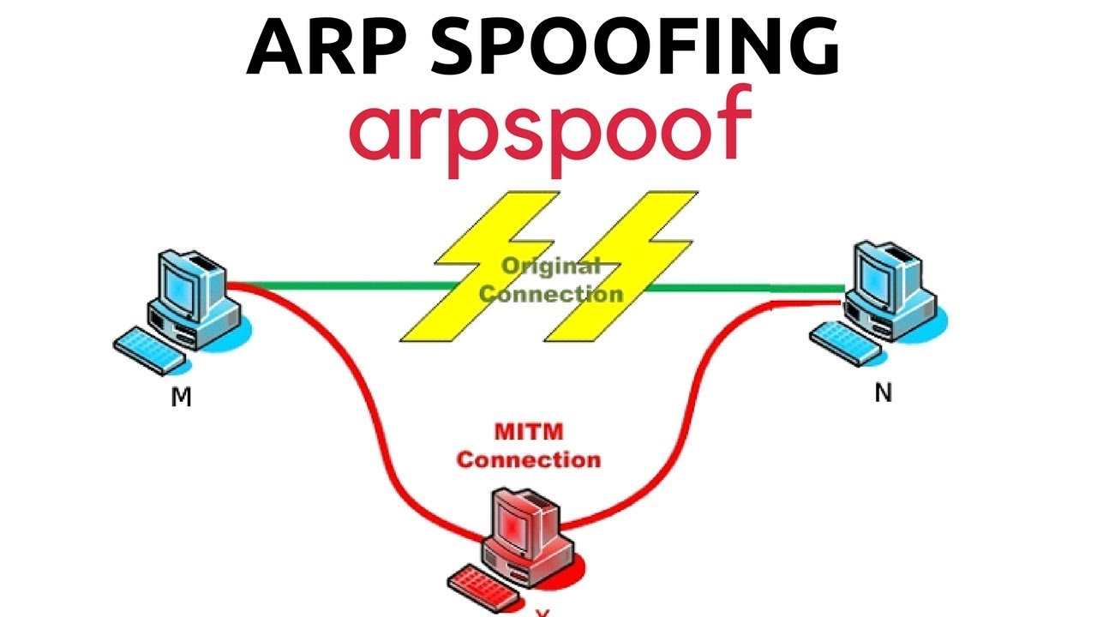
ARP Spoofing
ARP spoofing constructs a large number of forged
ARP request and reply packets to overload
the switch

Slide 4
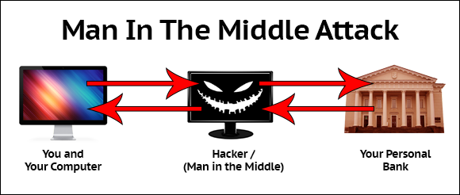
MITM

Slide 5
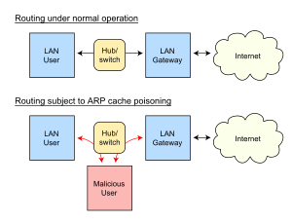
ARP Poisoning

Slide 6
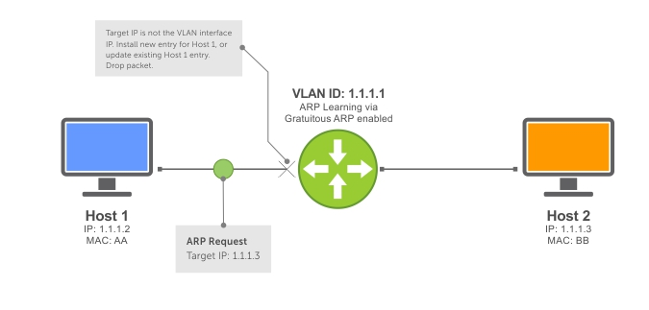
ARP Poisoning

Slide 7



